Slide 1
Contemporary Moral Problems
M-F12:00-1:00, SAV 264
Instructor: Benjamin Hole
Office Hours: M-F,1-1:15
Email: bvhole@uw.edu

Slide 2
Agenda
Clicker Quiz
Finish Ethical Relativism

Slide 3

CLICKER QUIZ
Please set your Turning Technology Clicker to channel 41
Press “Ch”, then “41”, then “Ch”

Slide 4
A utilitarian who recognizes rights will attempt to explain rights on the basis of utility by claiming that:
there are no moral rights; there is only utility
a moral right is a kind of claim that is justified because its recognition is conducive to the overall net welfare
a moral right is a kind of claim that is justified because it is wrong to use another person as a mere means to an ends
all of the above
none of the above

Slide 5
Kant’s Universal Law formulation does not refer to an agent’s wants or desires; rather, it represents:
an ethical dilemma
a criterion for social acceptability
a way to measure the value of an action’s consequences
a kind of consistency test
the golden rule
all of the above
none of the above

Slide 6
According to Rachels, the Eskimos differ from Americans in their:
attitudes toward food.
attitudes about burial of the dead.
attitudes toward infanticide.
attitudes about justice and fairness.
attitudes toward cultural relativism.
all of the above.
none of the above.

Slide 7

Ethical Relativism
(ER) “An act (performed by members of group G) is right if and only if the moral norms that are accepted by G permit the performance of the action.”

Slide 8
Cultural Differences Argument
Different cultures have different moral codes.
Therefore, there is no objective "truth" in morality. Right and wrong are only matters of opinion, and opinions vary from culture to culture.

Slide 9
What motivates ethical relativism?
If societies differ so much, how can there be any ethical truths?
Aren’t we (legitimately) frightened of imperialism and arrogance?

Slide 10
Five reasons why ethical relativism might be harder than it seems.

Slide 11
Five reasons why ethical relativism might be harder than it seems.
(1) While we may disagree in some values, there may be less disagreement than we think.

Slide 12
Herodotus, The Histories
“Darius, a king of ancient Persia, was intrigued by the variety of cultures he encountered in his travels. He had found, for example, that the Callatians (a tribe of Indians) customarily ate the bodies of their dead fathers. The Greeks, of course, did not do that—the Greeks practiced cremation and regarded the funeral pyre as the natural and fitting way to dispose of the dead. Darius thought that a sophisticated understanding of the world must include an appreciation of such differences between cultures. One day, to teach this lesson, he summoned some Greeks who happened to be present at his court and asked them what they would take to eat the bodies of their dead fathers. They were shocked, as Darius knew they would be, and replied that no amount of money could persuade them to do such a thing. Then Darius called in some Callatians, and while the Greeks listened asked them what they would take to burn their dead fathers' bodies. The Callatians were horrified and told Darius not even to mention such a dreadful thing.”

Slide 13

Martha Nussbaum
Objective list of values
Every society has had to come to terms with the same things - eating, sanitation, sex, the family, etcetera.

Slide 14
(2) We can accept context-sensitivity without being ethical relativists.
United States: thumb for good, middle finger for bad.
Reversia: thumb for bad, middle finger for good.
We might have a cross-cultural duty to avoid rudeness - with context-sensitive implications!

Slide 15


So a non-relativist has a good reason to avoid showing his thumb in reversia, and a good reason to avoid showing his middle finger in the United States!
We can accept this sort of diversity without thinking that ethics is only about what a society says.

Slide 16
Context Sensitivity
(CS) “The rightness or wrongness of an action may depend in part on facts about the agent and her circumstances, where her circumstances may include facts about the norms for what counts as constituting insults, a person’s privacy, proper respect for others, and so forth” (Timmons, 33).

Slide 17
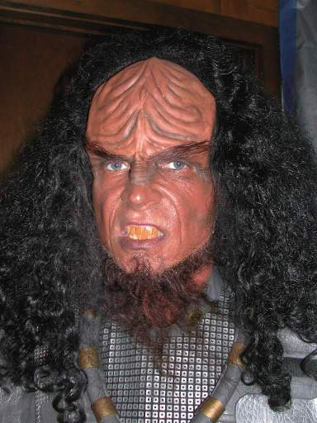
(3) Ethical relativism doesn’t support tolerance all that well.
Imagine a society where those who dissent are killed on sight. If ethical relativism is true, then the killers are right to kill their victims.

Slide 18
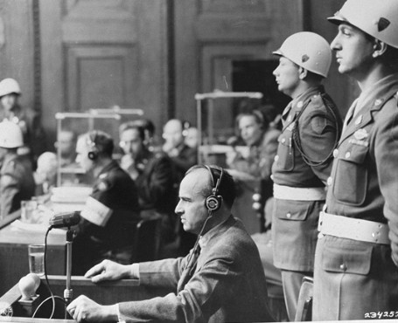
Ethical relativism thus makes human rights and external critique difficult.
If ethics is what a society says it is, and a society says that it has the right to commit murder, it is difficult for us to find a way to condemn human rights violations.

Slide 19
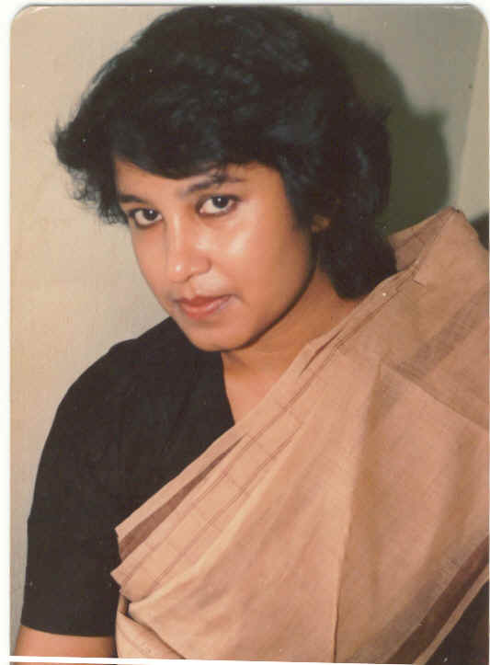
(4) Ethical relativism makes it difficult to criticize a society from the inside.
If we criticize what our society values, relativism argues that we’re not making any sense - ethics just is what our society values.

Slide 20

(5) Ethical relativism makes it difficult to gauge moral progress.

Slide 21
(5) Ethical relativism makes it difficult to gauge moral progress.
Compare United States racial attitudes in 1850 and in 2011. We might want to say that the latter set of attitudes is better. Relativism makes it hard for us to say that - we might have to say that the two are simply different!

Slide 22
Imagine you live in a society with cultural norms you find abhorrent. Rank how confident you are that you will stand by your convictions and act against your cultural norms.
Strongly Confident
Confident
Somewhat Confident
Neutral
Somewhat Unconfident
Unconfident
Strongly Unconfident

Slide 23
Imagine a possible world in which there are no cultures. In such a world, morality exists.
Strongly Agree
Agree
Somewhat Agree
Neutral
Somewhat Disagree
Disagree
Strongly Disagree

